Slide 1
Operating-System Services

Slide 2
Operating System Services
Operating systems provide an environment for execution of programs and services to programs and users
One set of operating-system services provides functions that are helpful to the user:
User interface - Almost all operating systems have a user interface (UI).
Varies between Command-Line (CLI), Graphics User Interface (GUI), touch-screen, Batch
Program execution - The system must be able to load a program into memory and to run that program, end execution, either normally or abnormally (indicating error)
I/O operations - A running program may require I/O, which may involve a file or an I/O device
File-system manipulation - The file system is of particular interest. Programs need to read and write files and directories, create and delete them, search them, list file Information, permission management.

Slide 3
Operating System Services (Cont.)
One set of operating-system services provides functions that are helpful to the user (Cont.):
Communications – Processes may exchange information, on the same computer or between computers over a network
Communications may be via shared memory or through message passing (packets moved by the OS)
Error detection – OS needs to be constantly aware of possible errors
May occur in the CPU and memory hardware, in I/O devices, in user program
For each type of error, OS should take the appropriate action to ensure correct and consistent computing
Debugging facilities can greatly enhance the user’s and programmer’s abilities to efficiently use the system

Slide 4
Operating System Services (Cont.)
Another set of OS functions exists for ensuring the efficient operation of the system itself via resource sharing
Resource allocation - When multiple users or multiple jobs running concurrently, resources must be allocated to each of them
Many types of resources - CPU cycles, main memory, file storage, I/O devices.
Logging - To keep track of which users use how much and what kinds of computer resources
Protection and security - The owners of information stored in a multiuser or networked computer system may want to control use of that information, concurrent processes should not interfere with each other
Protection involves ensuring that all access to system resources is controlled
Security of the system from outsiders requires user authentication, extends to defending external I/O devices from invalid access attempts

Slide 5
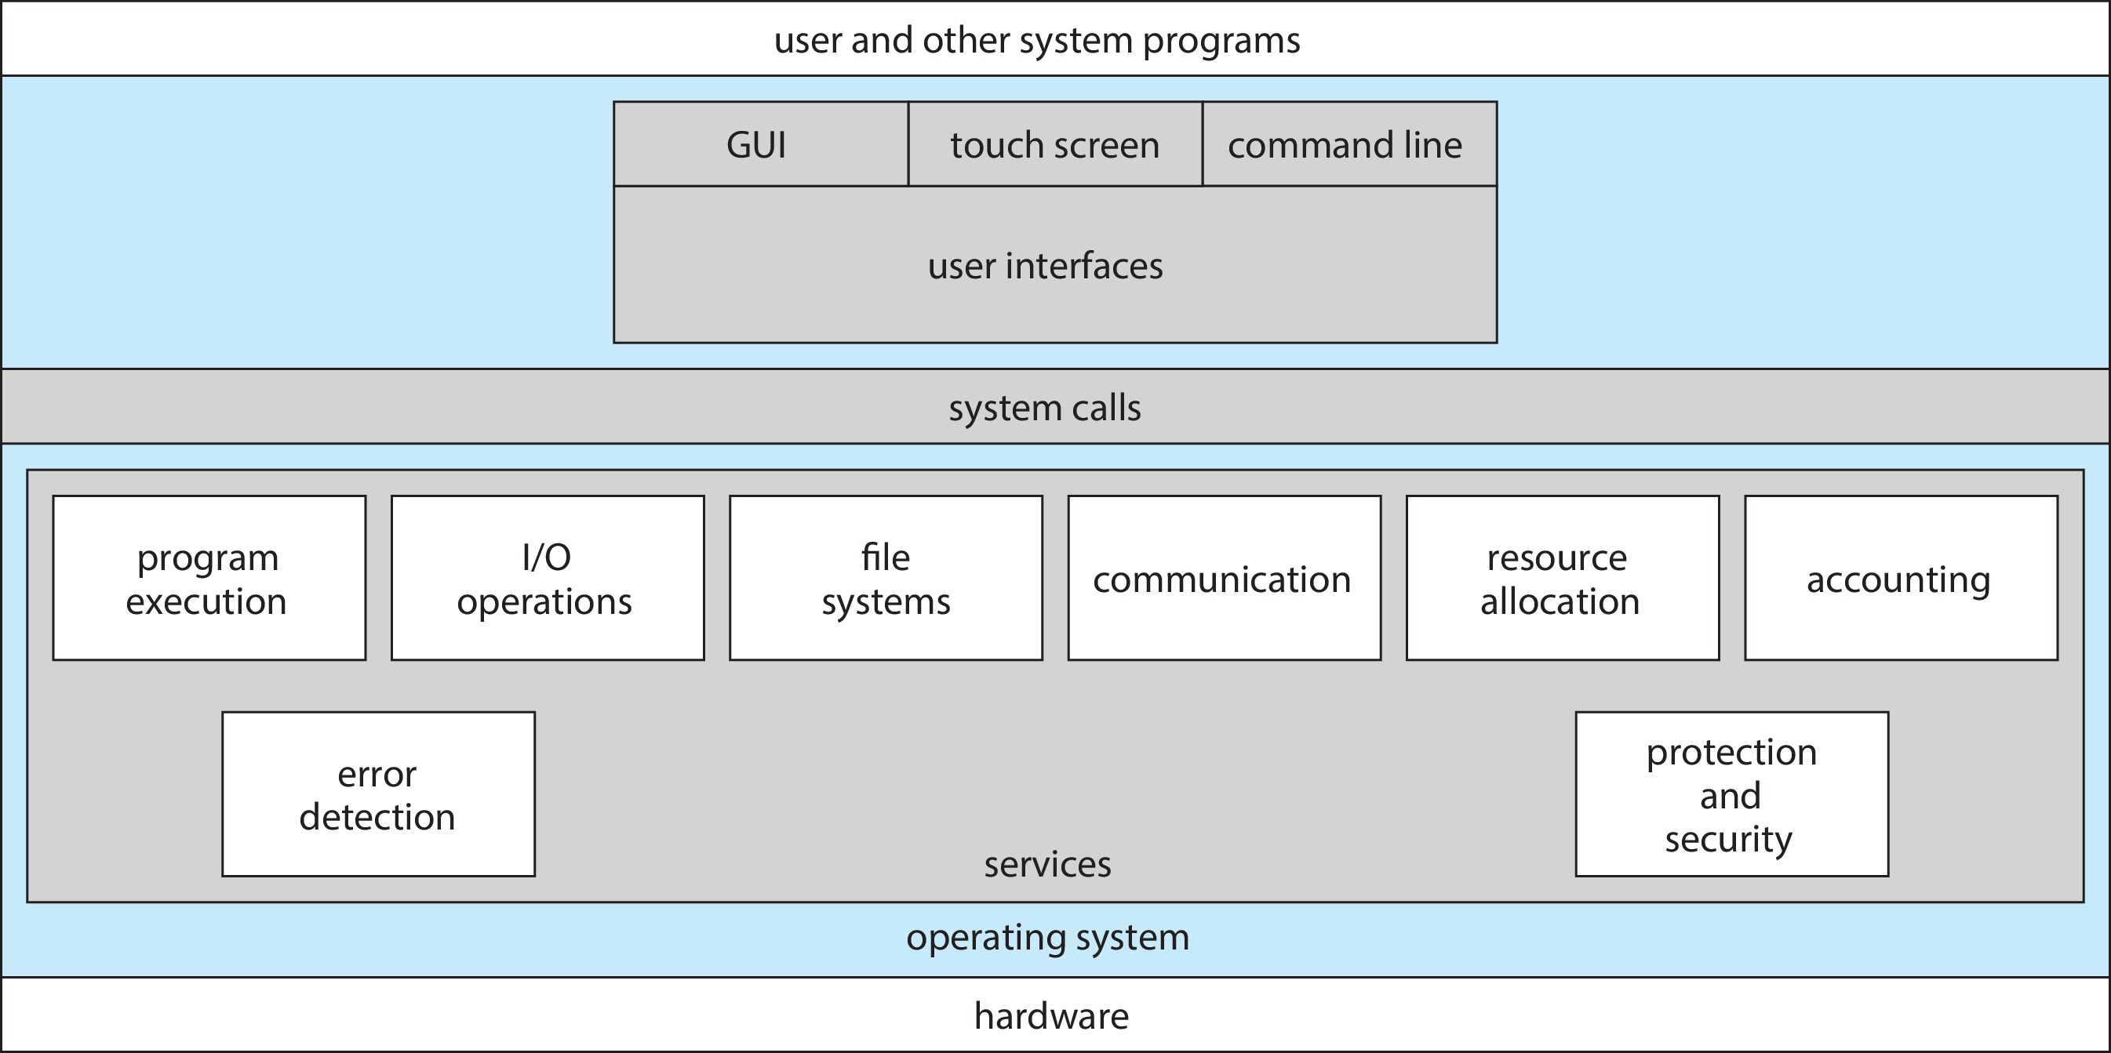
A View of Operating System Services

Slide 6
Command Line interpreter
CLI allows direct command entry
Sometimes implemented in kernel, sometimes by systems program
Sometimes multiple flavors implemented – shells
Primarily fetches a command from user and executes it
Sometimes commands built-in, sometimes just names of programs
If the latter, adding new features doesn’t require shell modification

Slide 7
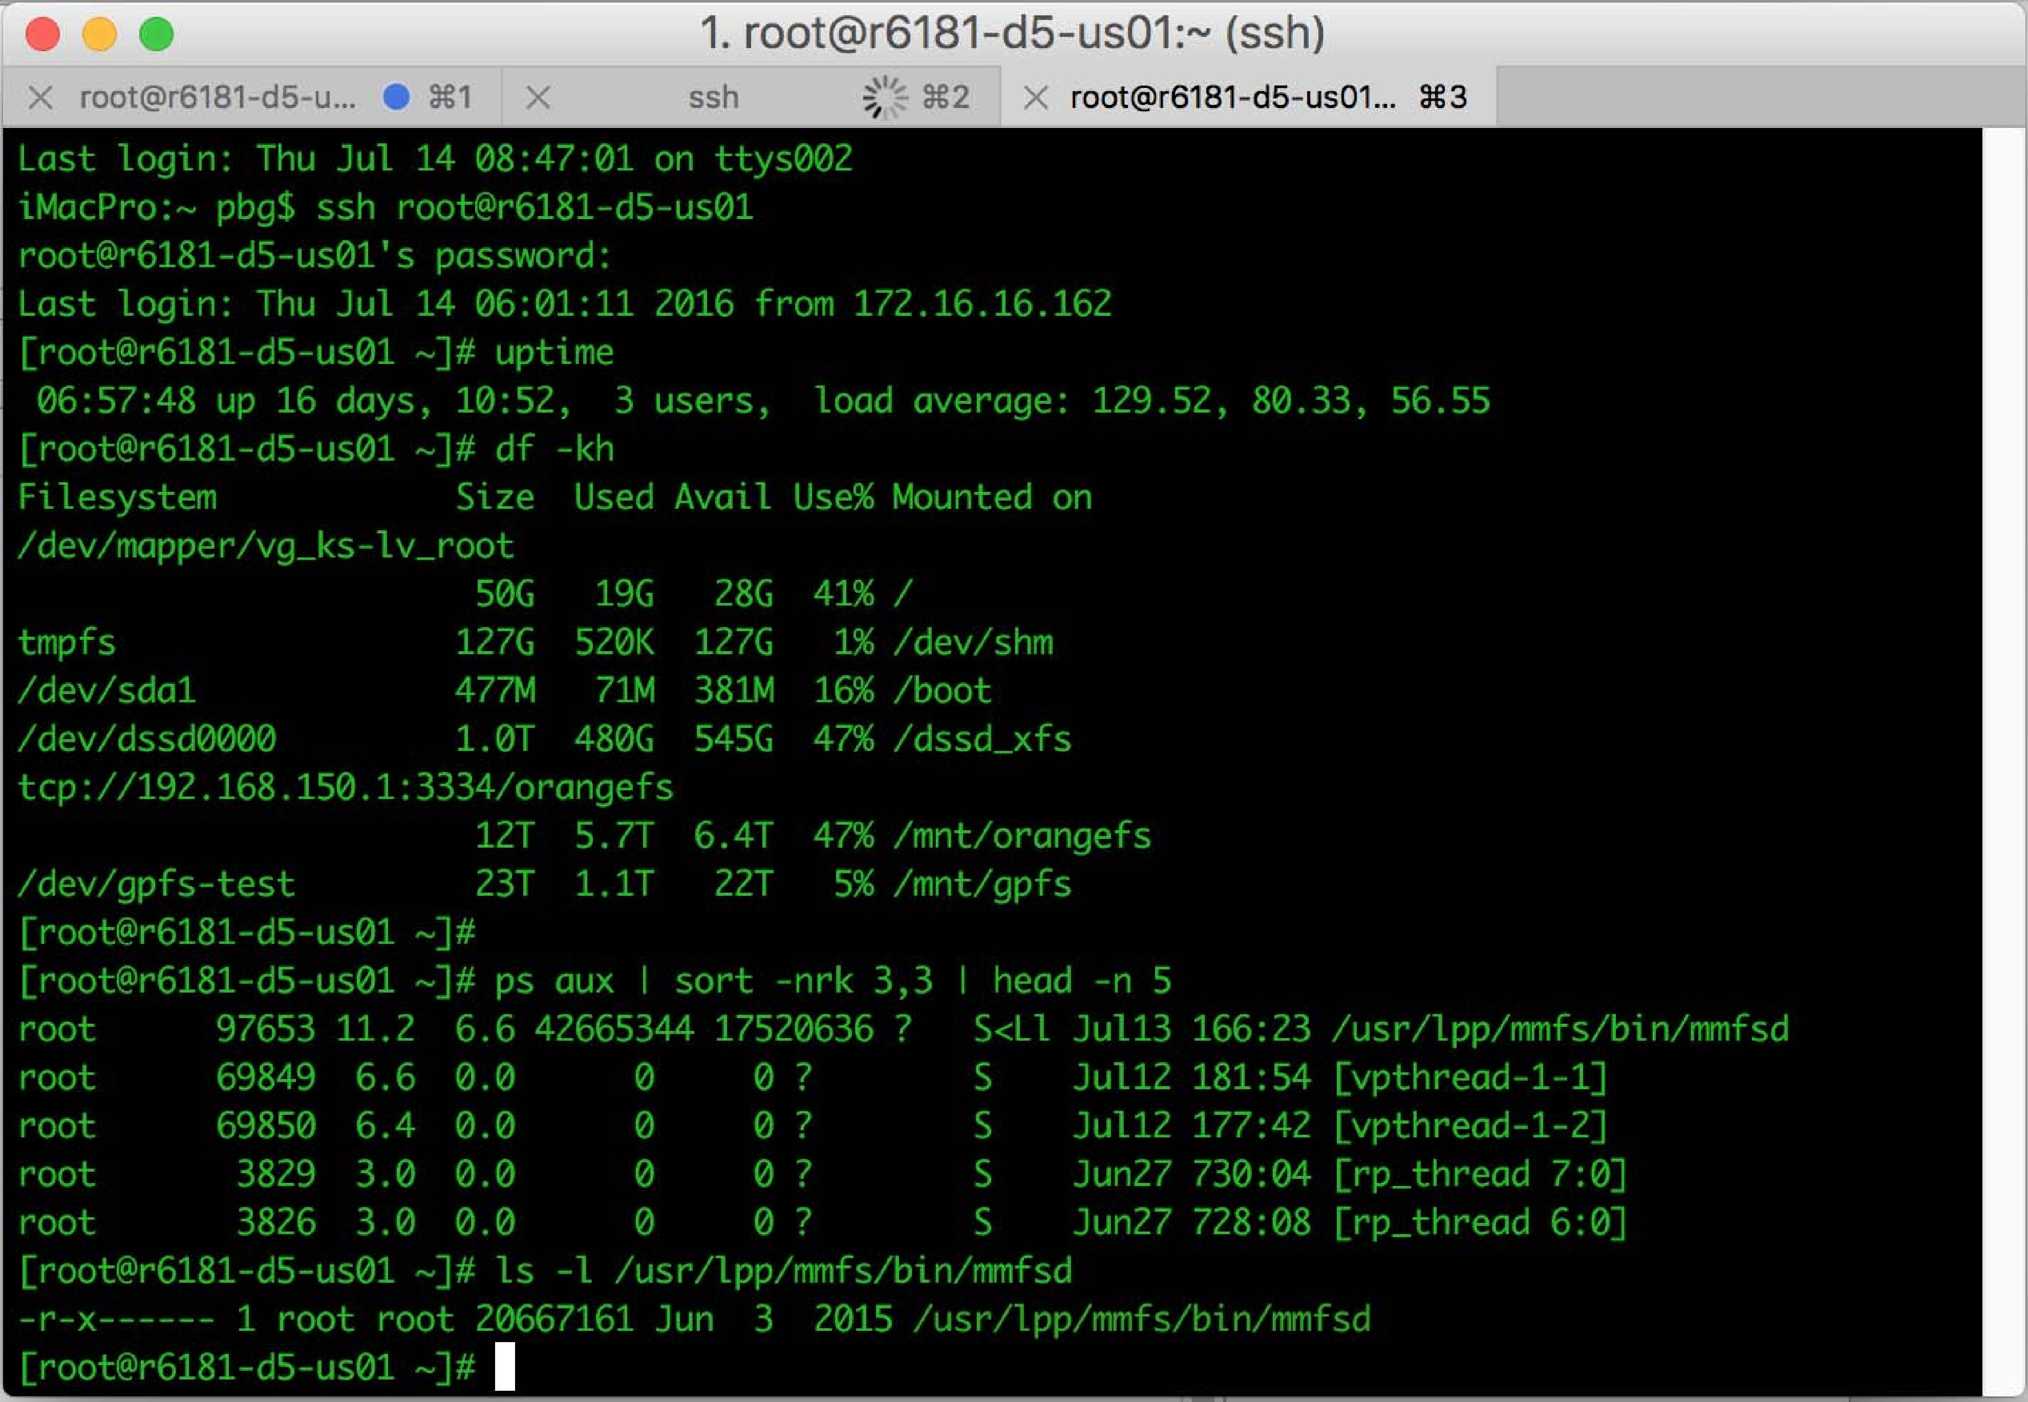
Bourne Shell Command Interpreter

Slide 8
User Operating System Interface - GUI
User-friendly desktop metaphor interface
Usually mouse, keyboard, and monitor
Icons represent files, programs, actions, etc
Various mouse buttons over objects in the interface cause various actions (provide information, options, execute function, open directory (known as a folder)
Invented at Xerox PARC
Many systems now include both CLI and GUI interfaces
Microsoft Windows is GUI with CLI “command” shell
Apple Mac OS X is “Aqua” GUI interface with UNIX kernel underneath and shells available
Unix and Linux have CLI with optional GUI interfaces (CDE, KDE, GNOME)

Slide 9

Touchscreen Interfaces
Touchscreen devices require new interfaces
Mouse not possible or not desired
Actions and selection based on gestures
Virtual keyboard for text entry
Voice commands

